Slide 1

Standardization in
Sustainable and Smart Cities Components and Initiatives
Abhishek Pal
Scientist ‘C’ (Civil Engg)
Bureau of Indian Standards
New Delhi

Slide 2
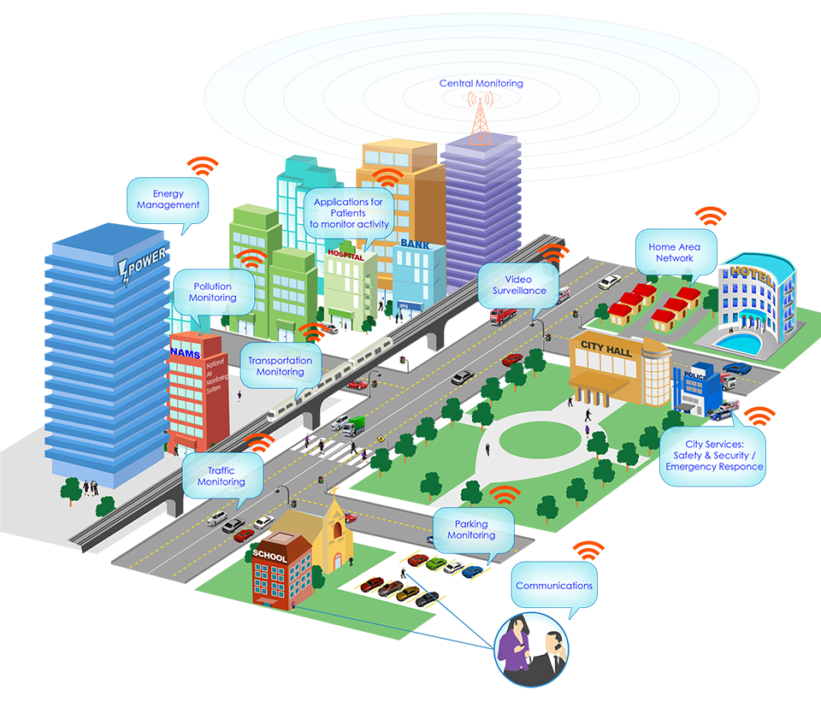
What is a Smart City ?

Slide 3
ISO’s definition of a Smart City :
City that increases the pace at which it provides social, economic and environmental sustainability outcomes and responds to challenges such as climate change, rapid population growth, and political and economic instability by fundamentally improving how it engages society, applies collaborative leadership methods, works across disciplines and city systems, and uses data information and modern technologies to deliver better services and quality of life to those in the city (residents, businesses, visitors), now and for the foreseeable future, without unfair disadvantage of others or degradation of the natural environment.

Slide 4
Definition may be simplified as:
A city that provides basic infrastructures to enhance the quality & performance of life and uses digital technologies with the principle of sustainable development & efficient use of resources and by effectively and actively involving its citizen.

Slide 5
Role of Standards in Smart City
To support the widespread adoption of common approaches to the implementation of smart city products and services.
The standards for smart cities would enable any city or civic authority to make efforts to improve its services in an objective and transparent manner at par with good international practices

Slide 6
CED 59 SMART CITIES SECTIONAL COMMITTEE
SCOPE – STANDARDIZATION IN THE FIELD OF SMART CITIES TERMINOLOGY, COMPONENTS, PLANNING, DESIGN, INTEGRATION, IMPLEMENTATION, OPERATION, MAINTENANCE AND ASSESSMENT
LIAISON:
ISO/TC 268 (P) SUSTAINABLE DEVELOPMENT IN COMMUNITIES
ISO/TC 268/SC 1 (P) SMART COMMUNITY INFRASTRUCTURE

Slide 7
Development of Indian Standards
Sustainable Development of Habitats – Indicators
Sustainable development of habitats ‒ Vocabulary
Sustainable development of habitats ‒ Indicators for resilient cities
Sustainable development of habitats – Transportation for Smart Cities
Sustainable development of habitats – Indicators for Smart Cities
Sustainable development of habitats – Infrastructure for Smart Cities

Slide 8
ISO Standards
ISO/TC 268 Sustaiable cities and communities
ISO 37100:2016 Sustainable cities and communities -- Vocabulary
ISO 37101:2016 Sustainable development in communities -- Management system for sustainable development -- Requirements with guidance for use
ISO 37104:2019 Sustainable cities and communities -- Transforming our cities -- Guidance for practical local implementation of ISO 37101
ISO 37106:2018 Sustainable cities and communities -- Guidance on establishing smart city operating models for sustainable communities
ISO 37120:2018 Sustainable cities and communities -- Indicators for city services and quality of life
ISO/TR 37121:2017 Sustainable development in communities -- Inventory of existing guidelines and approaches on sustainable development and resilience in cities
ISO 37122:2019 Sustainable cities and communities -- Indicators for smart cities

Slide 9
ISO Standards
ISO/TC 268/SC 1 Smart community infrastructures
ISO/TR 37150:2014 Smart community infrastructures -- Review of existing activities relevant to metrics
ISO/TS 37151:2015 Smart community infrastructures -- Principles and requirements for performance metrics
ISO/TR 37152:2016 Smart community infrastructures -- Common framework for development and operation
ISO 37153:2017 Smart community infrastructures -- Maturity model for assessment and improvement
ISO 37154:2017 Smart community infrastructures -- Best practice guidelines for transportation
ISO 37157:2018 Smart community infrastructures -- Smart transportation for compact cities
ISO 37159:2019 Smart community infrastructures -- Smart transportation for rapid transit in and between large city zones and their surrounding areas

Slide 10
Indicators
The smart cities or development can be achieved through proper understanding of the qualitative and quantitative measures
a quantitative, qualitative or descriptive measure
defines and establishes methodologies for a set of parameter to steer and measure the performance of city services and quality of life.
it considers sustainability as its general principle and resilience as a guiding concept

Slide 11
Indicators
Criteria:
Completeness
Technology
Simplicity
Verifiability
Availability
Cities can choose the appropriate set of indicators depending on their objectives in term of smartness:

Slide 12
Elements of Smart and
Sustainable Indicators
Economy Education Energy Environment Finance Governance Health Housing Recreation | Safety Sewerage and Sanitation Solid Waste Telecommunication & innovation Transportation Urban planning Water supply

Slide 13
Economy
Gross Domestic Product (GDP) for the City
GDP Per capita
Gini coefficient
City’s Unemployment Rate
Assessed Value of Commercial and Industrial Properties as a Percentage of Total Assessed Value of all Properties
Number of Businesses per 100000 Population
Survival rate of new businesses per 100 000 population
labour force employed in occupations in the information and communications technology (ICT) sector, education and research and development sectors

Slide 14
Education
Percentage of Female School-aged Population Enrolled in Schools
Percentage of Students Completing Primary Education: Survival Rate
Percentage of Students Completing Secondary Education: Survival Rate
Primary Education Student/Teacher Ratio
Percentage of School-aged Population Enrolled in Schools
Number of computers, laptops, tablets or other digital learning devices available per 1 000 students
Number of science, technology, engineering and mathematics (STEM) higher education degrees per 100000 population

Slide 15
Energy
The Percentage of Total Energy Derived from Renewable Sources, as a Share of the City’s Total Energy Consumption
Total Electrical Energy Use per Capita (kWh/year)
Total Residential Electrical Energy use per Capita (kWh/year)
Average Number of Electrical Interruptions per Customer per Year
Average Length of Electrical Interruptions (in Hours)
Percentage of Transmission & Distribution (T&D) Losses

Slide 16
Energy
Electrical and thermal energy produced from wastewater treatment, solid waste and other liquid waste treatment and other waste heat resources, as a share of the city’s total energy
Storage capacity of the city’s energy grid
Percentage of street lighting managed by a light performance management system
Percentage of buildings in the city with smart energy meters
Number of electric vehicle charging stations per registered electric vehicle

Slide 17
Environment & Climate Change
Concentration of Fine Particulate Matter (PM_{2.5}), Particulate Matter (PM₁₀) , Nitrogen Dioxide (NO2), Sulphur Dioxide (SO2), Ozone (O3)
Green House Gas Emissions Measured in Tonnes per Capita
Air Quality Index
Noise Pollution
Quality of Public Water Bodies
Number of electric vehicle charging stations per registered electric vehicle
Number of real-time remote air quality monitoring stations
Percentage of public buildings equipped for monitoring indoor air quality

Slide 18
FINANCE
Debt Service Ratio (Debt Service Expenditure as a Percentage of Municipality’s Own-Source Revenue)
Capital Spending as a Percentage of Total Expenditures
Own-Source Revenue as a Percentage of Total Revenues
Tax Collected as a Percentage of Tax Billed
Percentage of payments to the city that are paid electronically based on electronic invoices
Annual amount of revenues collected from the sharing economy as a percentage of own-source revenue

Slide 19
GOVERNANCE
Voter Participation in Last Municipal Election
Women as a Percentage of Total Elected to City-Level Offices
Women Employed in the City Workforce
Number of Convictions for Corruption by City Officials per 100 000 Population
Citizens’ Representation: Number of local official elected to office per 100 000 Population
Number of Registered Voters as a Percentage of the Voting Age Population
Annual number of online visits to the municipal open data portal per 100 000 population
Percentage of city services accessible and that can be requested online
Average response time to inquiries made through the city’s non-emergency inquiry system
Average downtime of the city’s IT infrastructure

Slide 20
HEALTH
Average Life Expectancy at Birth
Under Age Five Mortality per 1 000 Live Births
Number of In-Patient Hospital Beds per 100 000 Population
Number of Physicians per 100 000 Population
Number of Disabled Persons per 100 000 Population
Number of Nursing and Midwifery Personnel per 100 000 Population
Suicide Rate per 100 000 Population
city’s population with an online unified health file accessible to health care providers
Percentage of the city population with access to real-time public alert systems for air and water quality advisories

Slide 21
HOUSING
Percentage of City Population Living in Slums
Number of Homeless per 100 000 Population
Percentage of Households that Exist Without Registered Legal Titles
Percentage of Households With Smart Energy Meter
Percentage of Households With Smart Water Meter

Slide 22
RECREATION
Public Indoor Recreation Space per Capita
Public Outdoor Recreation Space per Capita
Number of Art Galleries, Museums, Cultural Centres per 100 000 Population
Percentage of public recreation services that can be booked online

Slide 23
SAFETY
Number of Police Personnel per 100 000 Population
Number of Homicides per 100 000 Population
Crimes Against Women per 100 000 Population
Response Time for Police and Fire Departments from Initial Call
Violent Crime Rate Per 100 000 Population
Number of Professional Firefighters Per 100 000 Population
Number of Fire Related Deaths Per 100 000 Population
Number of Natural Disaster Related Deaths per 100 000 Population
Response Time for Emergency Response Services from Initial Call
Percentage of the city area covered by digital surveillance cameras

Slide 24
SEWERAGE AND SANITATION
City Population Having Access to Sanitary Toilet Facilities
City Population Served by Sewage (Wastewater) Collection
City’s Wastewater that has Received no Treatment
City’s Wastewater Receiving Primary Treatment and Secondary Treatment
City’s Wastewater that is being Recycled and Reused
Percentage of treated wastewater being reused

Slide 25
SOLID WASTE
Percentage of City Population Covered with Regular Solid Waste Collection (Residential)
Total Collected Municipal Solid Waste per capita per year
Percentage of the City’s Solid Waste that is Recycled
Percentage of the City’s Solid Waste that is Disposed of in a Sanitary Landfill
Percentage of the City’s Solid Waste that is Disposed of in an Incinerator
Percentage of the City’s Solid Waste that is Burned Openly
Percentage of the City’s Solid Waste that is Disposed off in an Open Dump
Percentage of the City’s Solid Waste that is Disposed of by other means
Percentage of biosolids that are reused (dry matter mass)

Slide 26
Solid Waste
Percentage of the city population that has a door-to-door garbage collection with an individual monitoring of household waste quantities
Percentage of total amount of waste in the city that is used to generate energy
Percentage of total amount of plastic waste recycled in the city
Percentage of public garbage bins that are sensor-enabled public garbage bins
Percentage of the city’s electrical and electronic waste that is recycled

Slide 27
TELECOMMUNICATION AND INNOVATION
Number of internet connections per 100 000 population
Percentage of Households with Computer
Percentage of Households with Internet Access
Cyber Security Readiness for ICT infrastructure and Online citizen service delivery
Number of new patents per 100 000 population per year
Percentage of city area under a white zone/dead spot/not covered by telecommunication connectivity
Percentage of the city population with access to sufficiently fast broadband

Slide 28
TRANSPORTATION
Kilometres of high Capacity Public Transport System
Kilometres of light Passenger Public Transport system
Annual number of Public Transport Trips per capita
Percentage Share of Electric Vehicles as part of total Vehicles in a City
Percentage of Road Network with usable Pedestrian Pathway/ Footpath network
Percentage of Road Network with Cycling Lanes
Transportation Fatalities per 10 000 Population

Slide 29
TRANSPORTATION
Number of users of sharing economy/public transportation
Percentage of vehicles registered in the city that are low-emission vehicles
Percentage of public transport lines equipped with a publicly accessible real-time system
Percentage of public parking spaces equipped with e-payment systems real-time availability systems
Percentage of traffic lights that are intelligent/smart
City area mapped by real-time interactive street maps as a percentage of the city’s total land area

Slide 30
URBAN PLANNING
Notified Master Plan for Integrated Land use
Green Area (hectares) per 100 000 population
Aerial size of informal settlements as a Percentage of City Area
Jobs/housing ratio
Urban Flooding
Basic Services Proximity
Average time for building permit approval
Percentage of building permits submitted through an electronic submission system

Slide 31
WATER SUPPLY
Percentage of City Population with Potable Water Supply Service
Total Domestic Water Consumption per capita (liters/day)
Total Water Consumption per capita (liters/day)
Total Water Supply through Metered Water Connections
Average Annual hours of Water Service Interruption per household
Percentage of Water Loss (unaccounted for water)
Compliance Rate of Drinking Water Quality
Percentage of the city’s water distribution network monitored by a smart water system
Percentage of drinking water tracked by real-time water quality monitoring station

Slide 32
Conclusion
Smartness is to be treated as a means rather than in isolation as an objective.
The ultimate objective is sustainability and smartness acts as an accelerator for the same.
Roles of Citizen

Slide 33
Thank You

